Slide 1
Chart types

Slide 2
Bar Chart :
A Bar Chart compares values between different categories. The length or height of each bar represents the value.
Best Used For
Sales by Product
Marks by Student
Revenue by Region
Example Data:
Product | Sales
Laptop | 120
Mobile | 180
Tablet | 90
Monitor | 150

Slide 3
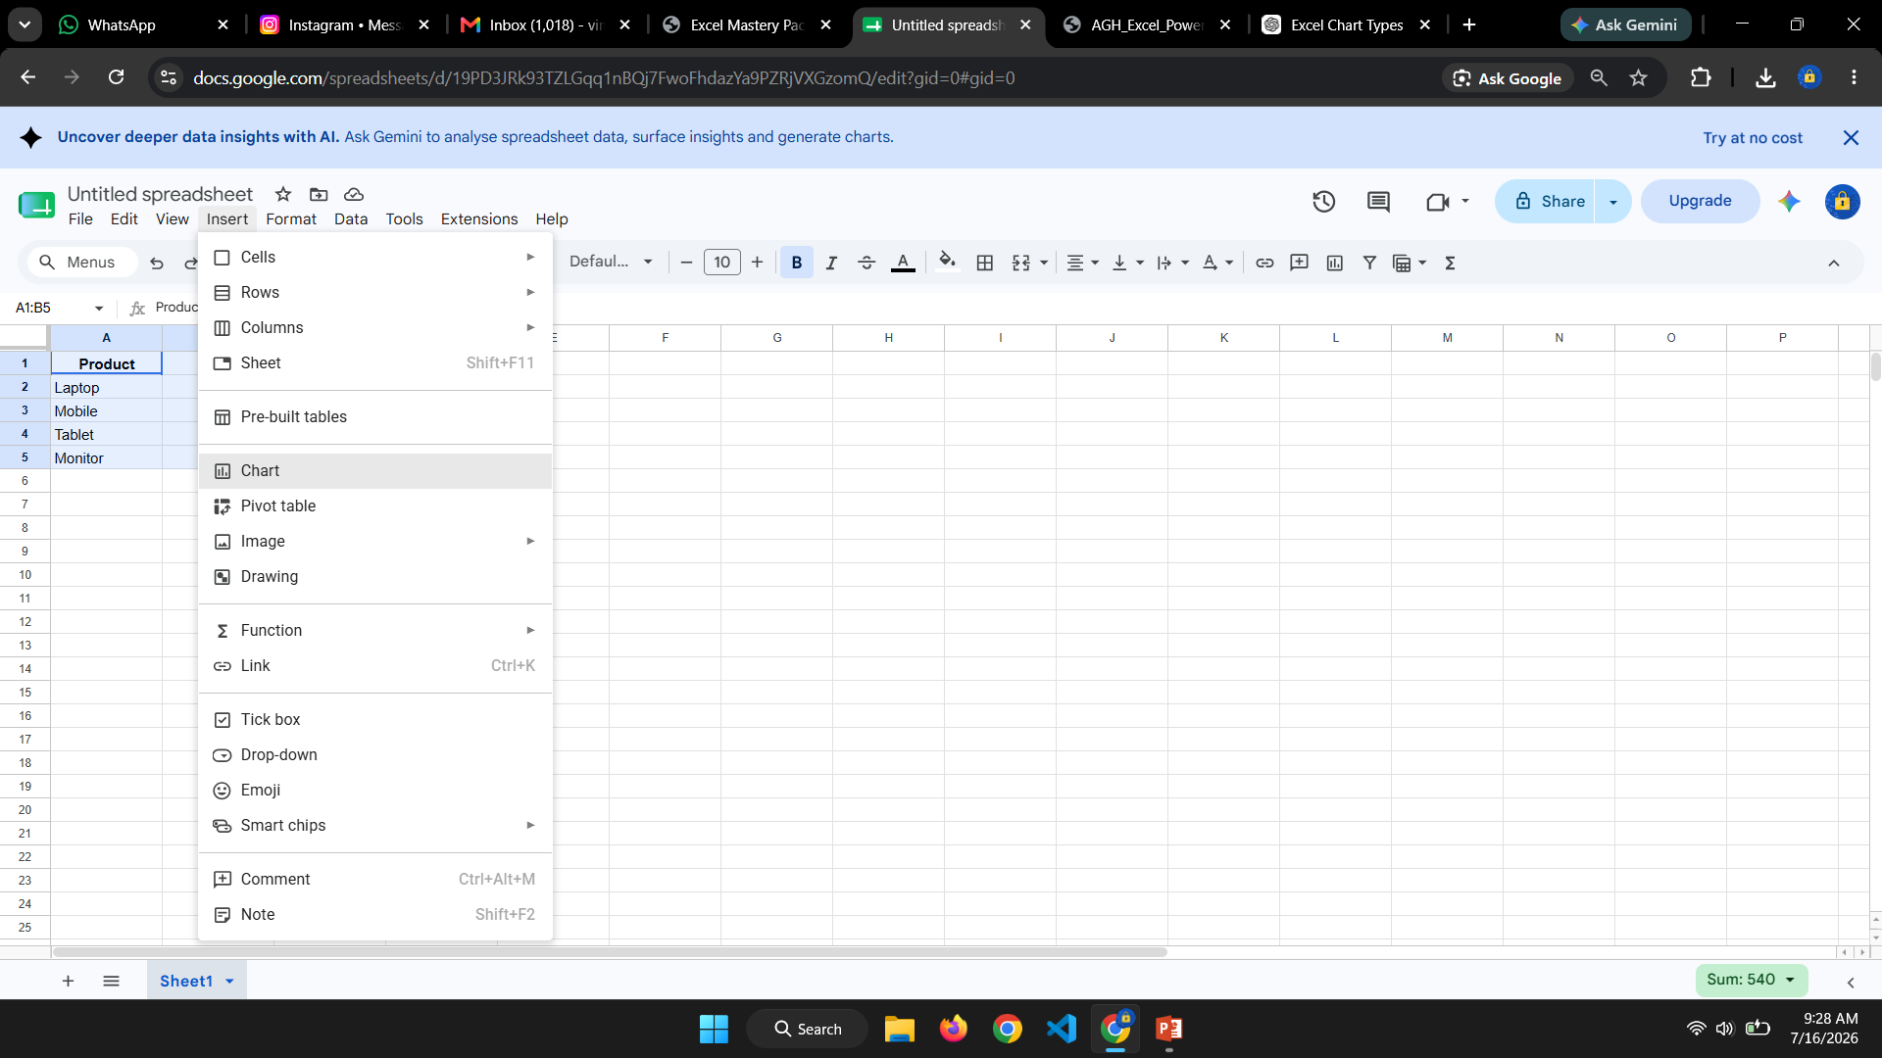
Select table
insert - Chart

Slide 4
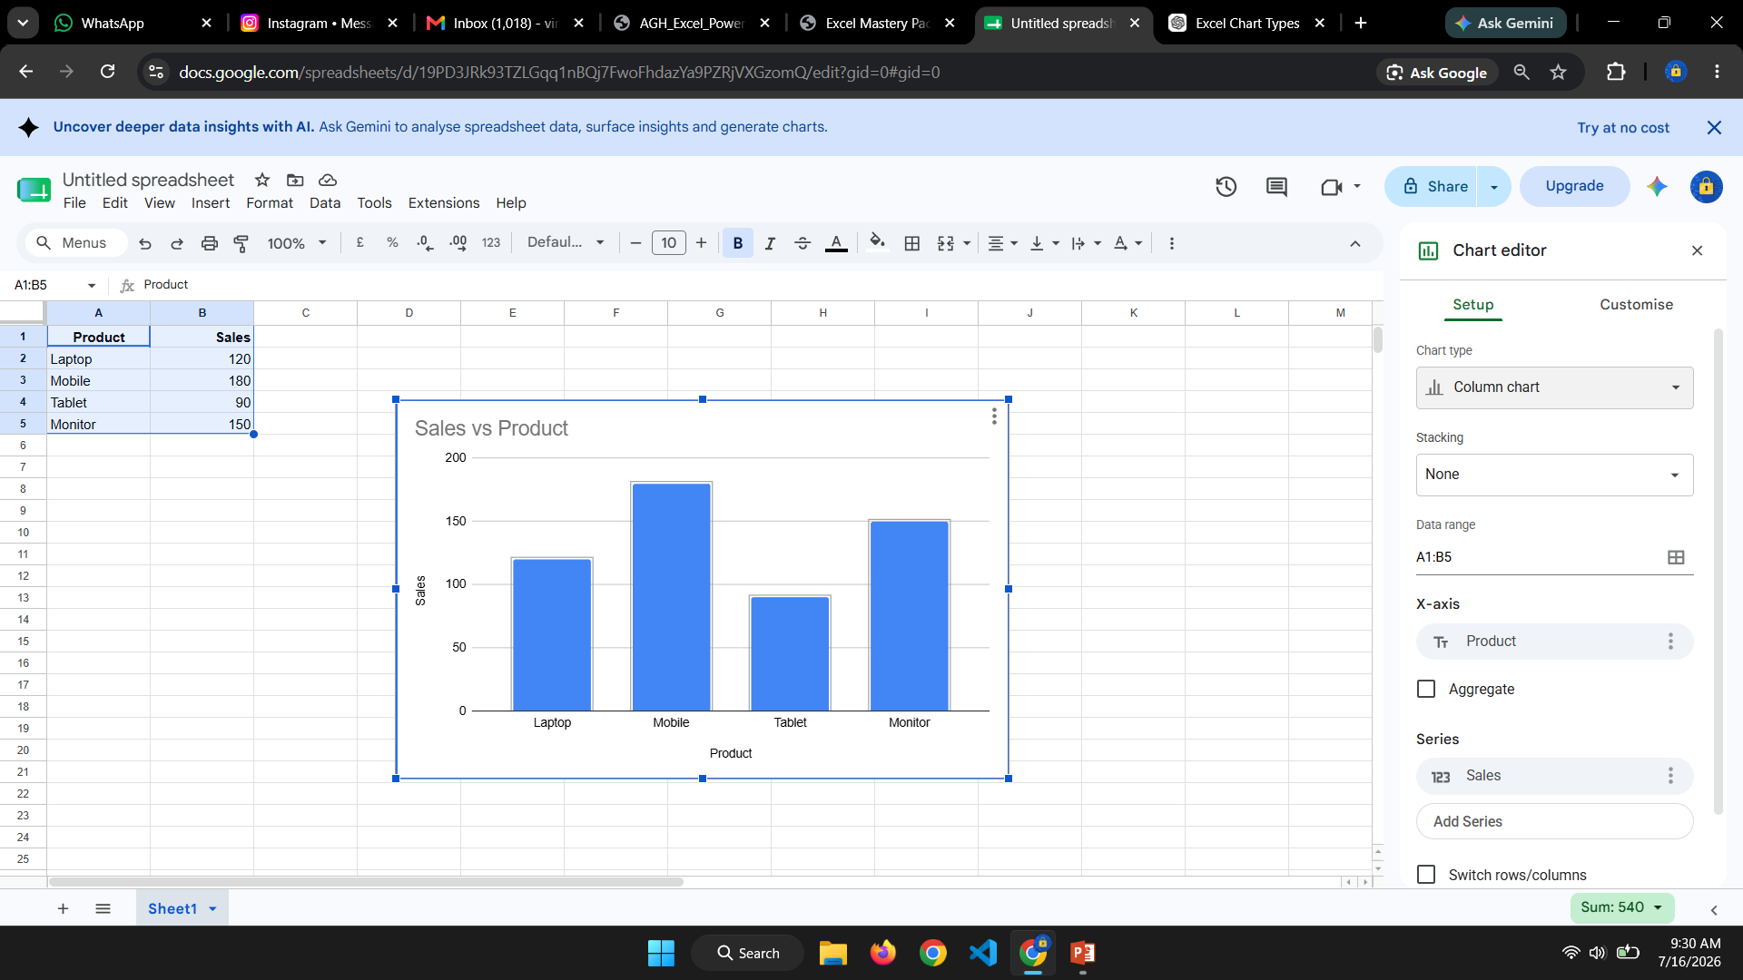

Slide 5
Line Chart:
A Line Chart shows changes or trends over time.
Best Used For
Monthly Sales
Temperature
Website Visitors
Formula
Monthly Growth
=(B3-B2)/B2
Example Data:
Month | Sales
Jan | 120
Feb | 140
Mar | 160
Apr | 180
May | 170

Slide 6
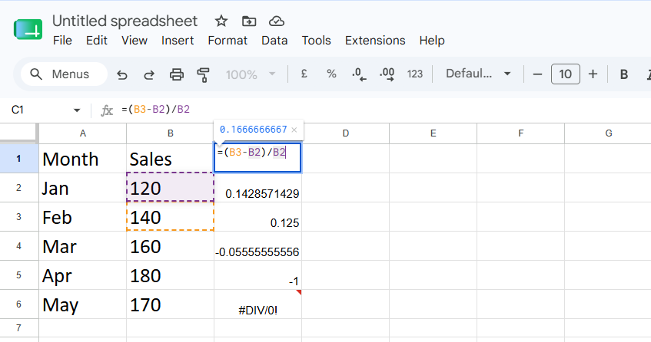

Slide 7
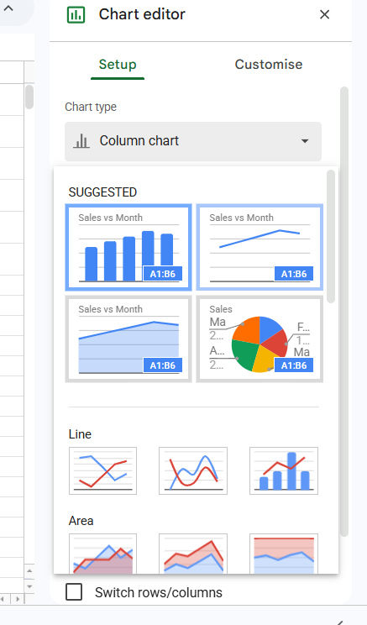

Slide 8
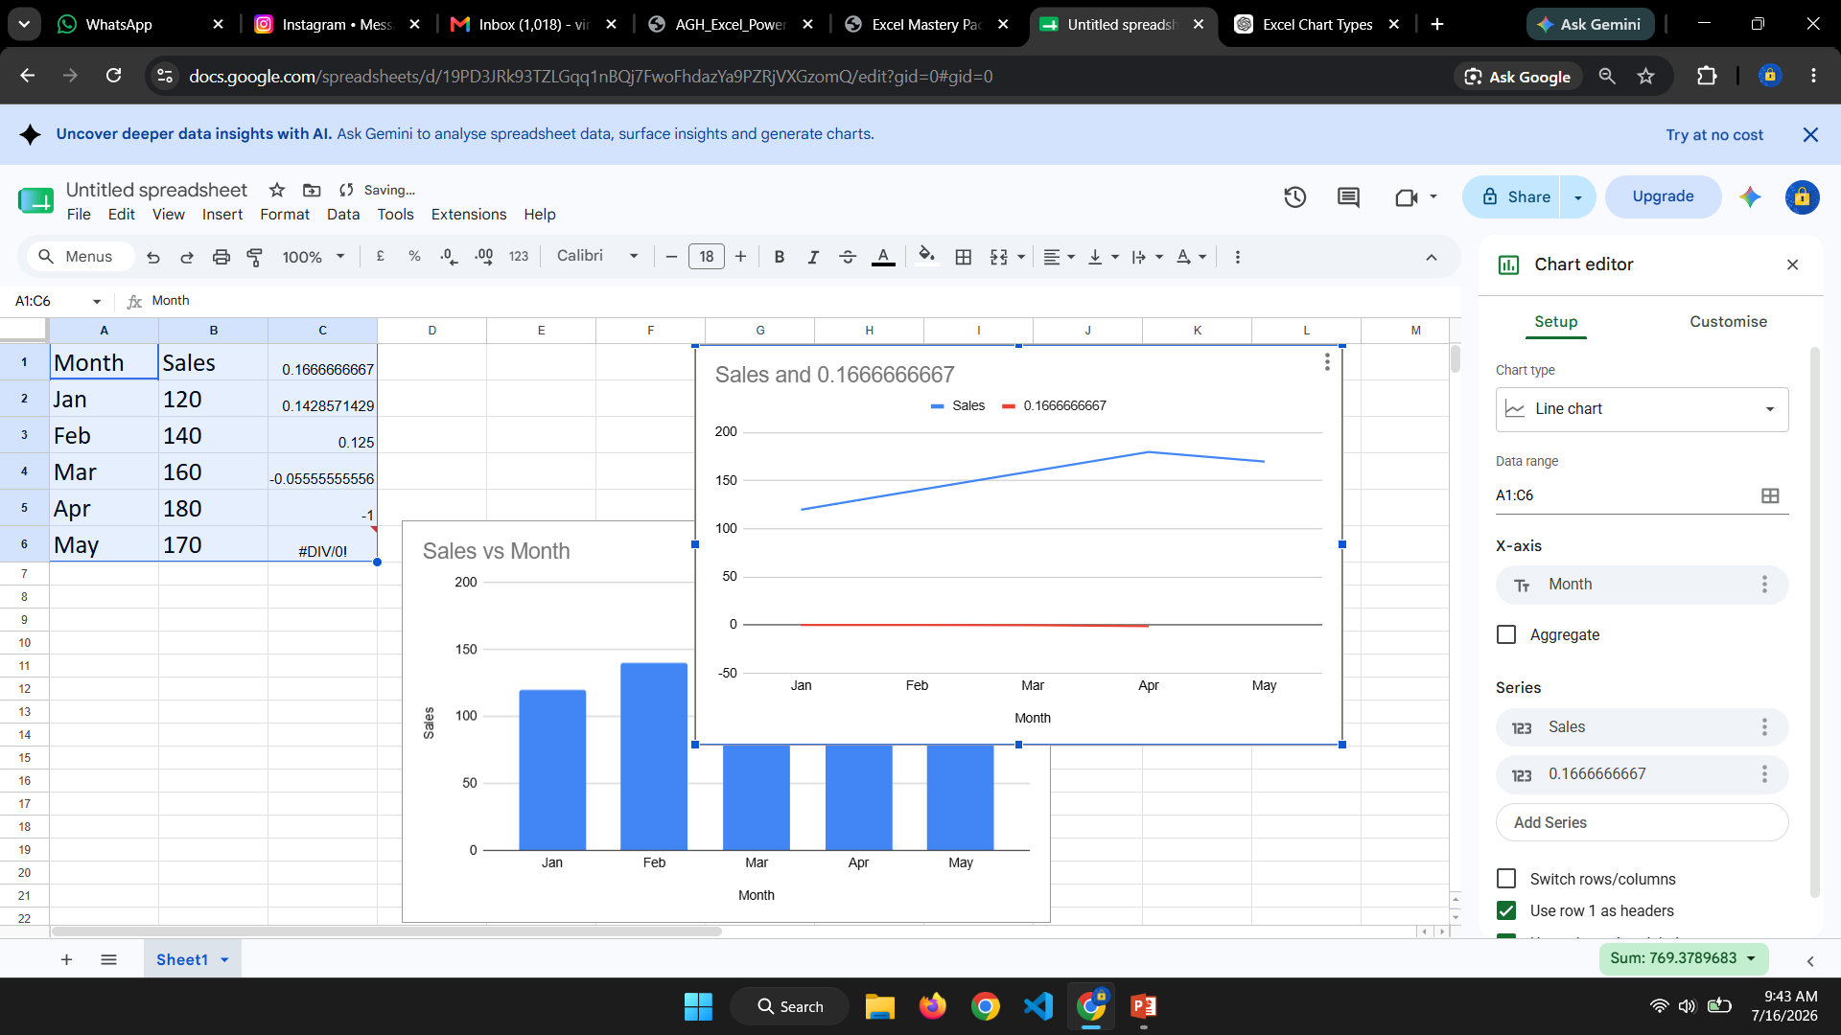
Select Data Insert Line Chart

Slide 9
Combo Chart
A Combo Chart combines two chart types.
Column = Sales
Line = Profit
Month | Sales | Profit
Jan | 120 | 25
Feb | 140 | 30
Mar | 180 | 40
Apr | 160 | 35

Slide 10
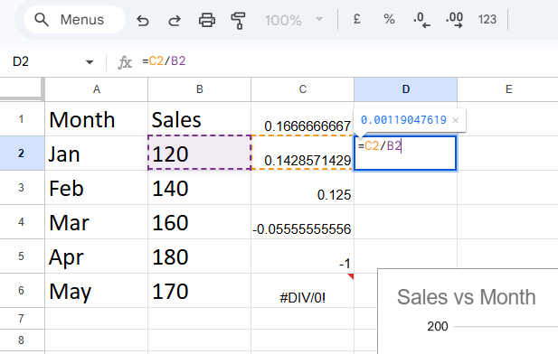
Formula :
Profit %
=C2/B2
Select combo chart in this setup

Slide 11
Waterfall Chart:
Shows how increases and decreases affect the final total.
Category | Amount
Opening | 1000
Sales | 500
Expenses | -300
Tax | -100
Closing | 1100
Running Total
=B2
Next row
=C2+B3

Slide 12
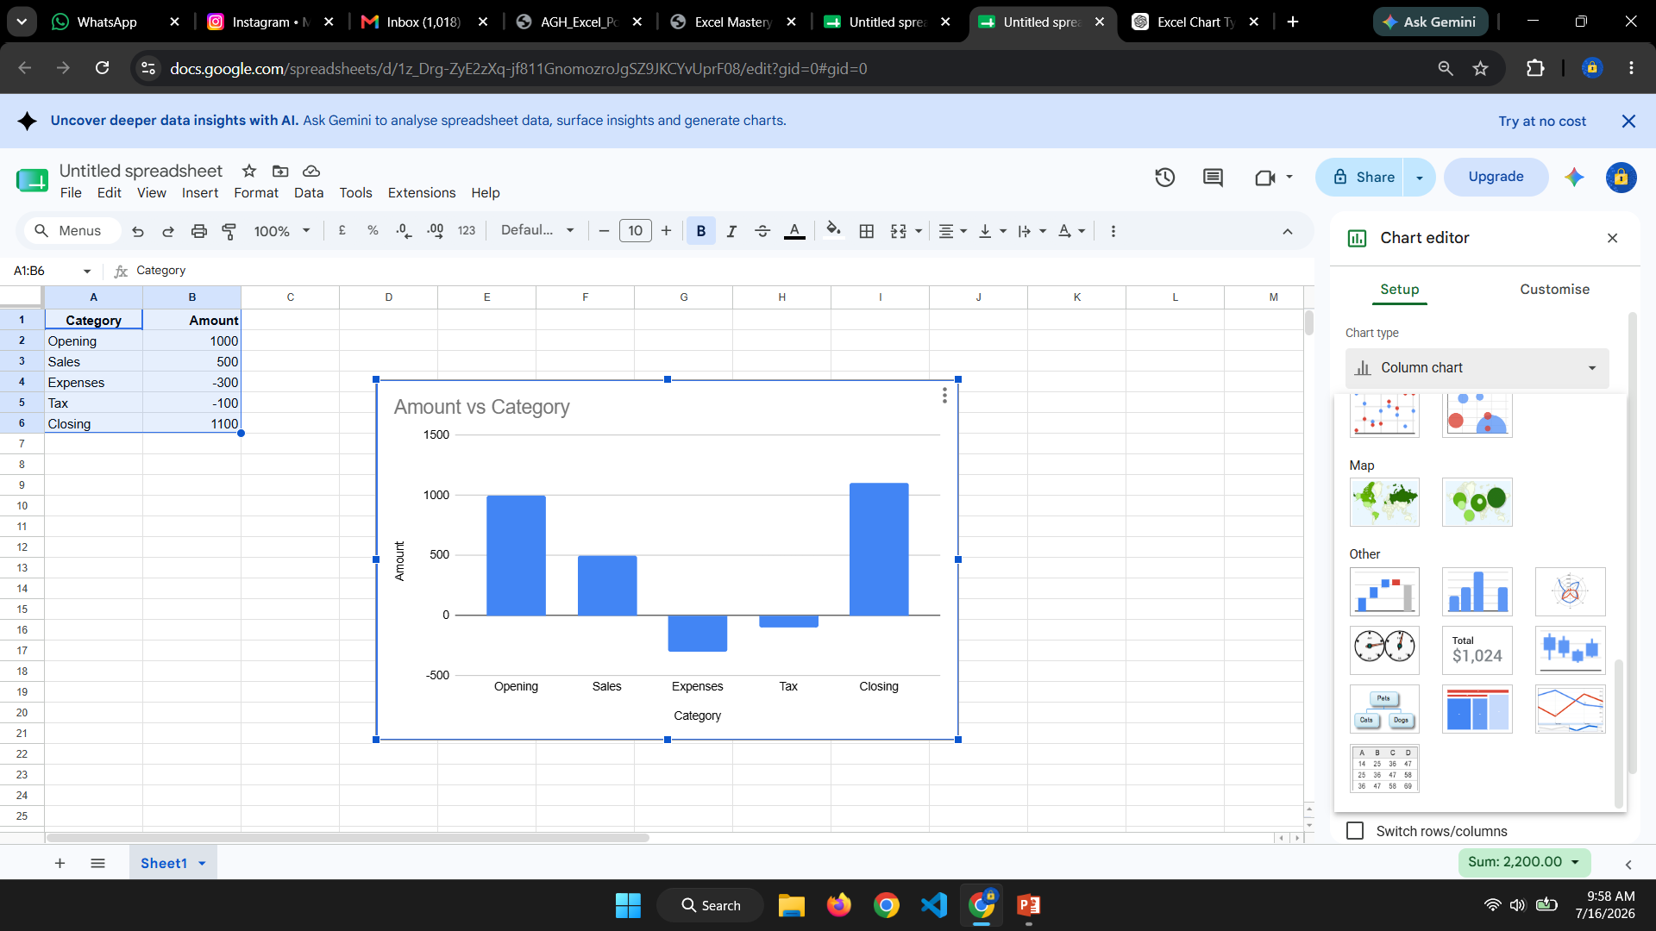
Select this water fall chart from others:

Slide 13
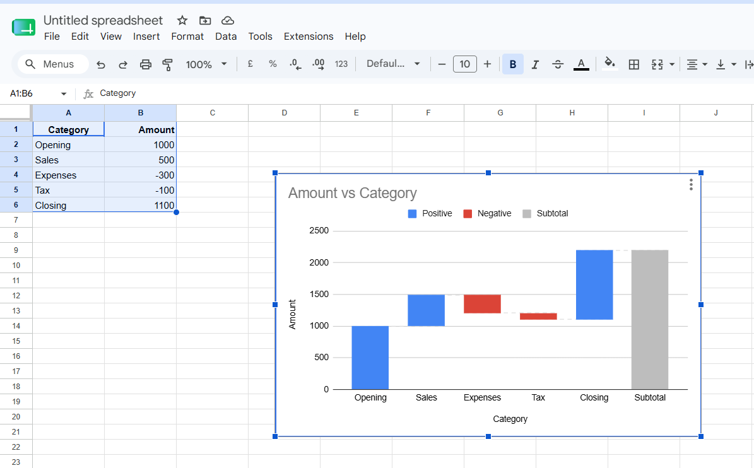
Water fall chart :

Slide 14
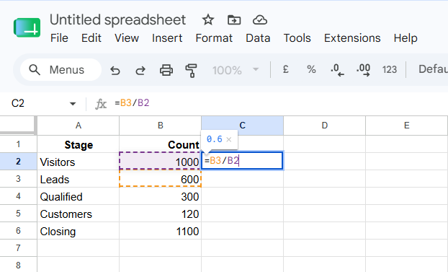
Funnel Chart
Shows values decreasing through different stages.
Stage | Count
Visitors | 1000
Leads | 600
Qualified | 300
Customers | 120

Slide 15
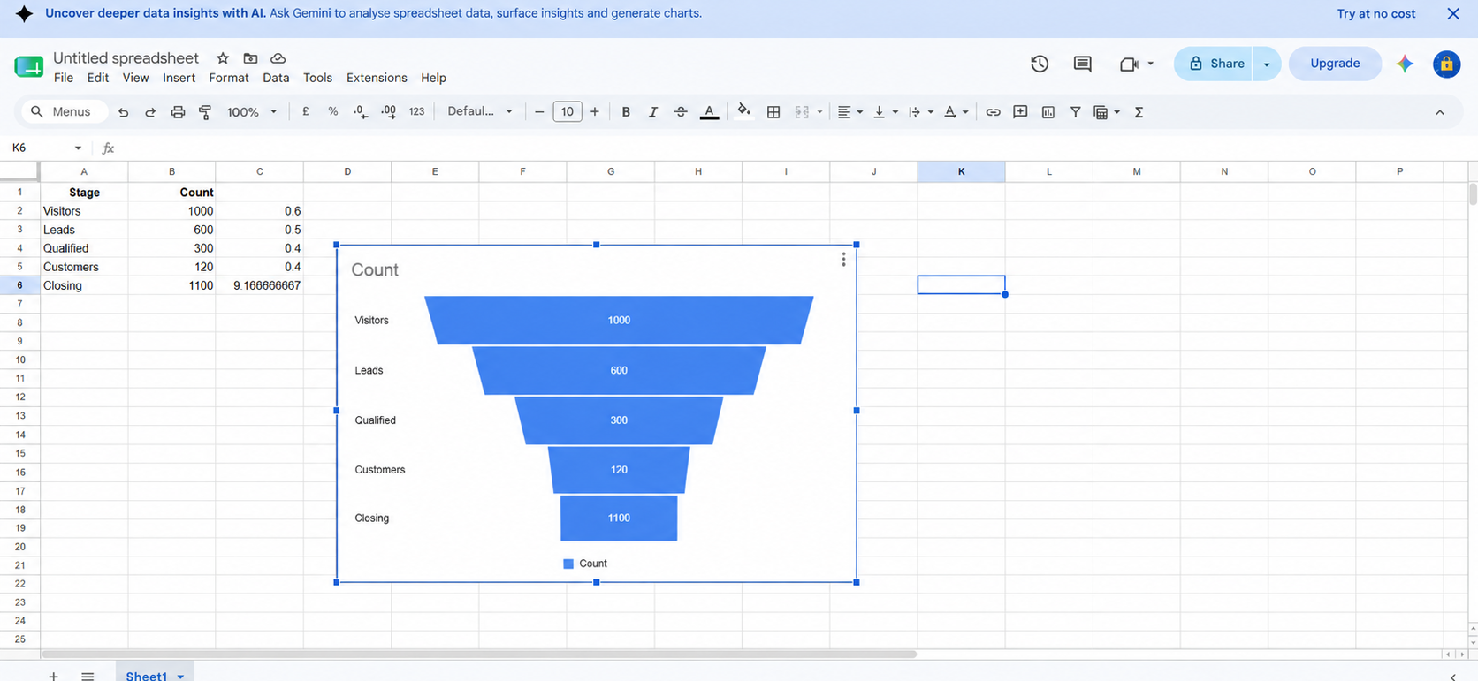

Slide 16
Scatter Chart :
Shows the relationship between two numerical values.
Sample Data
Study Hours | Marks
2 | 45
3 | 55
4 | 65
5 | 72
6 | 85

Slide 17
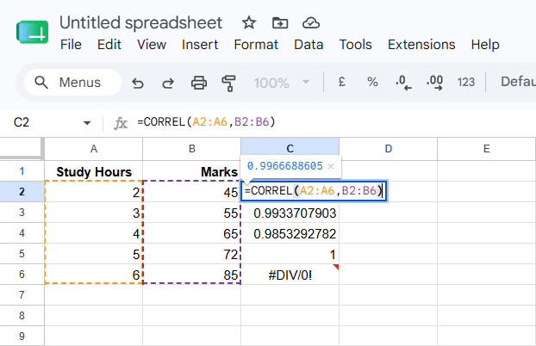
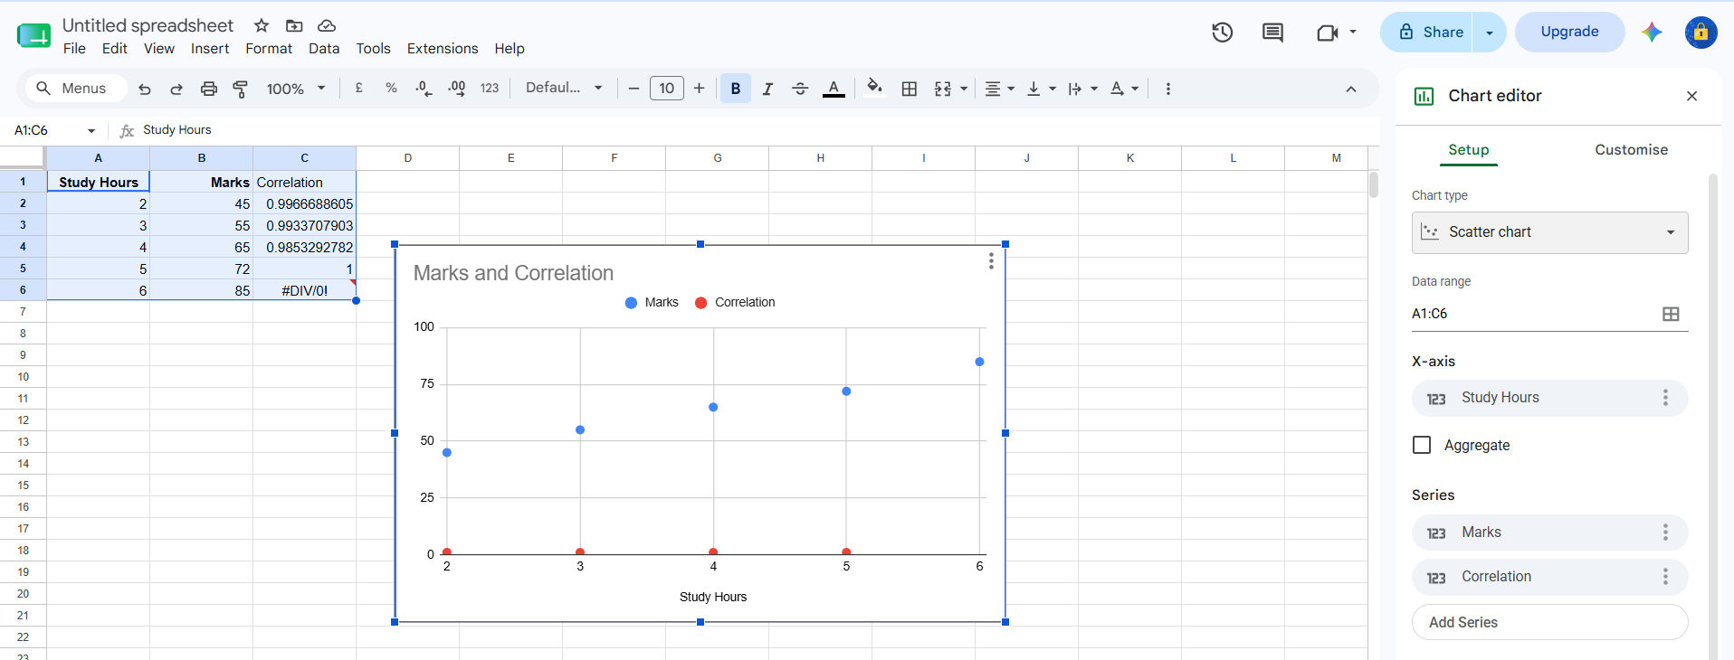
Correlation
=CORREL(A2:A6,B2:B6)

Slide 18
Scatter chart :

Slide 19
Histogram :
Groups numerical data into ranges (bins) and shows how many values fall into each range.
Scores
45
52
56
60
62
68
70
74
80
85
88
92
Formula
Frequency
=FREQUENCY(A2:A13,C2:C6)
Create Chart
Select Data
↓
Insert
↓
Histogram

Slide 20
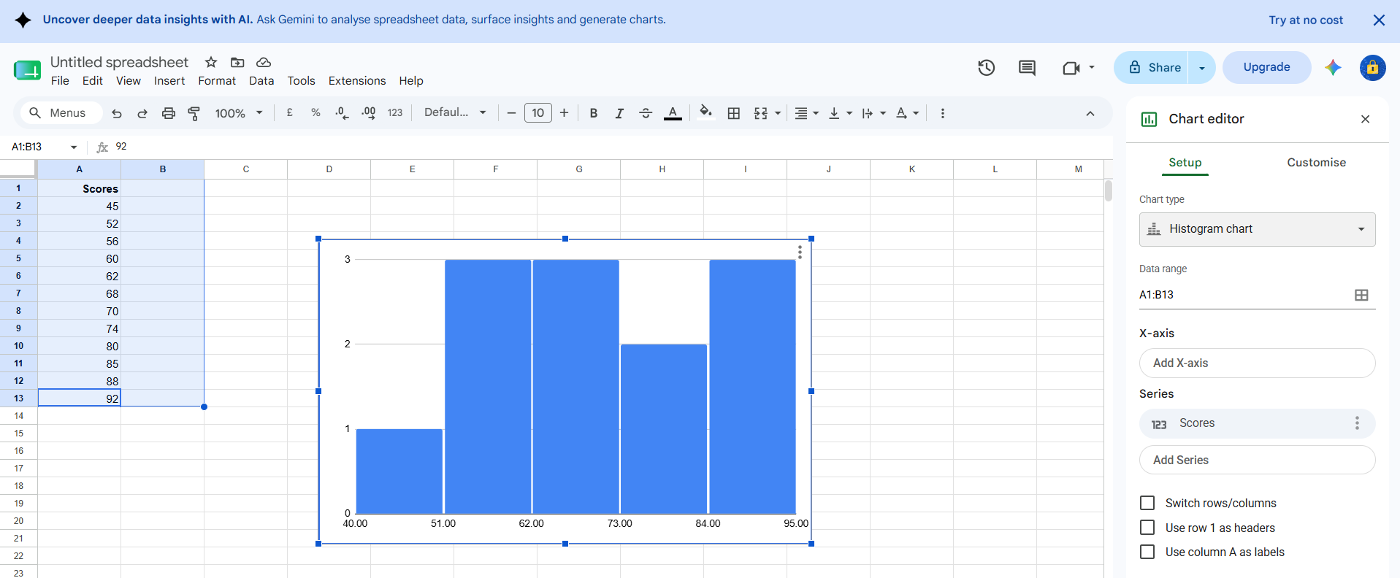
Histogram Chart :

